Slide 1
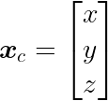

Collision Detection, Isolation and Identification with Base F/T Sensor
{True, False}
Professor: Alessandro De Luca
Candidate: Alessandro Paglialunga
Course: Elective in Robotics | Physical Human-Robot Interaction

Slide 2
Outline
Introduction
Preliminaries
Dynamic Model
Extended Dynamic Model
Extended Momentum-Based Disturbance Observer
Project implementation
Simulations & Results
Conclusions

Slide 3

Introduction
Goal: External Force Estimation
Assumptions:
Rigid Robot
Pure Force
Single Contact Location

Slide 4


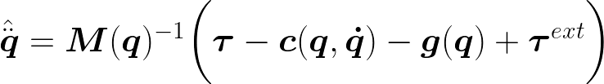
Introduction
Problem:
Contact Jacobian is not Full Rank:
Singularity
Collision occurs below the 6th joint
Problems:
Nonlinear Coupling
High Noise

Slide 5
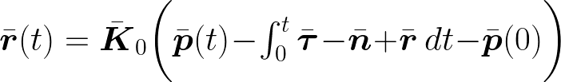
Introduction
Solution: Extended Momentum-Based Disturbance Observer
Properties:
Configuration-Independent
Singularity-Free
Uncoupled
No Need of Acceleration Measurements/Estimates
Simultaneous Contact Locations can be detected

Slide 6
Preliminaries

Slide 7
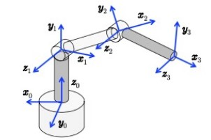
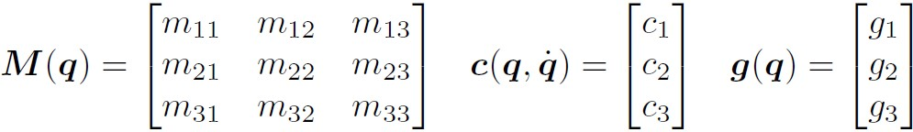

Dynamic Model

Slide 8
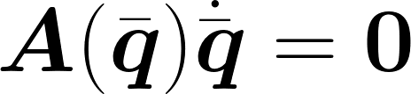
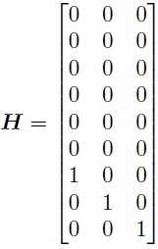

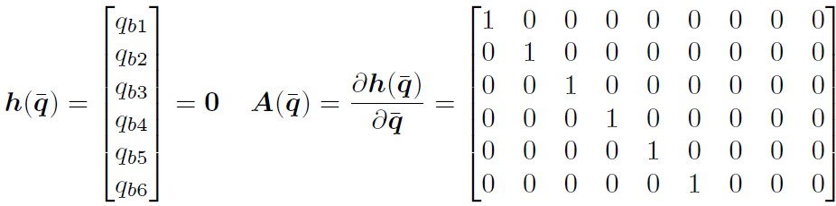

Extended Dynamic Model

Slide 9
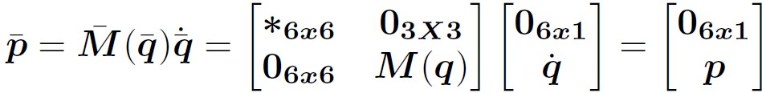
Extended Momentum-Based Disturbance Observer

Slide 10
Project Implementation

Slide 11
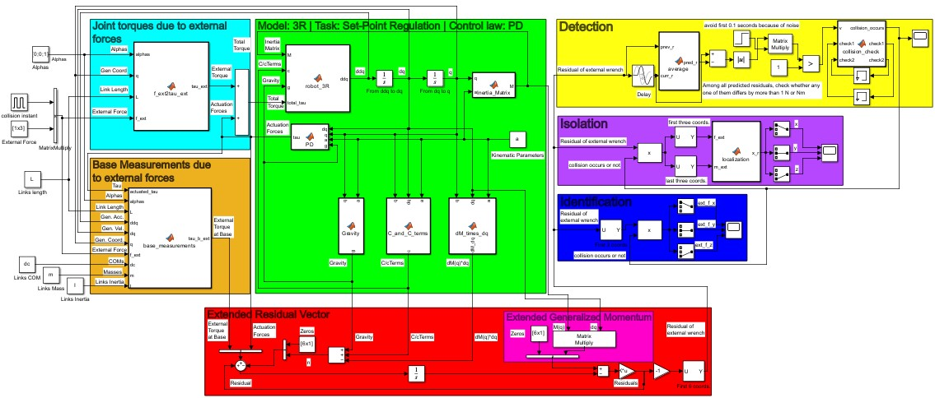
Project Implementation

Slide 12

Project Implementation
Eternal Force Estimation
Extended Residuals
Base Measurements
Extended Momentum
Extended n
Gen. Coords and Gen Velocities
Control Law
External Torques

Slide 13
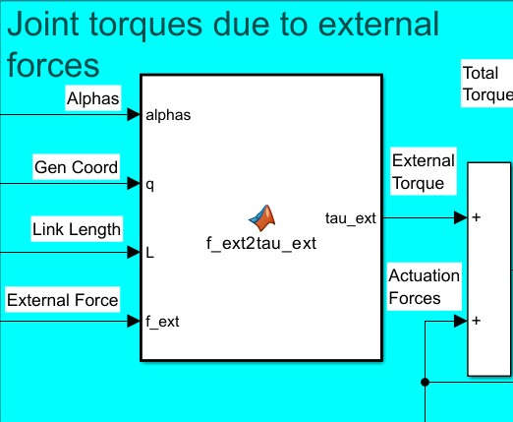
Project Implementation

Slide 14
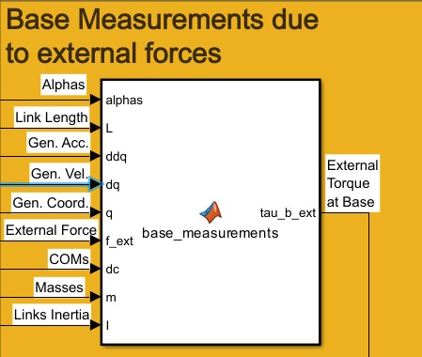
Project Implementation
from the inverse dynamics using Newton-Euler

Slide 15
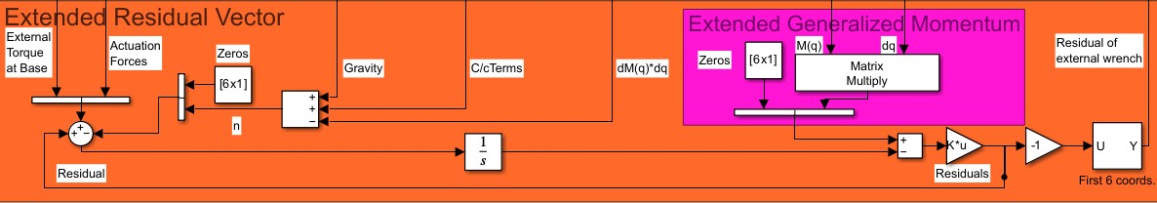
Project Implementation

Slide 16
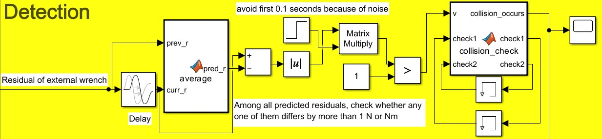
Project Implementation

Slide 17
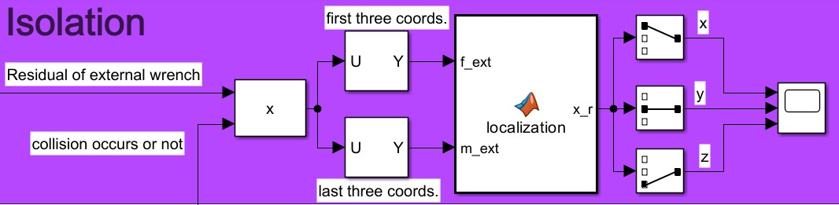

Project Implementation

Slide 18
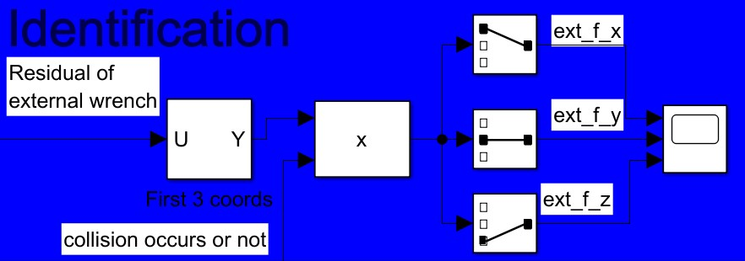
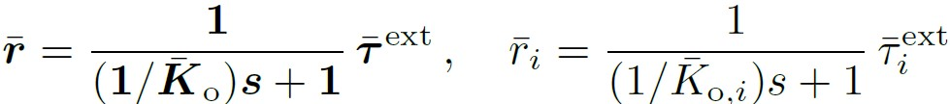
Project Implementation

Slide 19
Simulations & Results

Slide 20
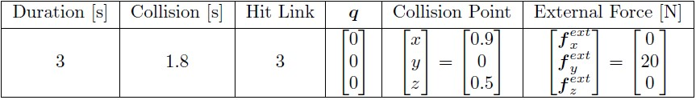
First Simulation
Below the 6th joint
Singularity

Slide 21
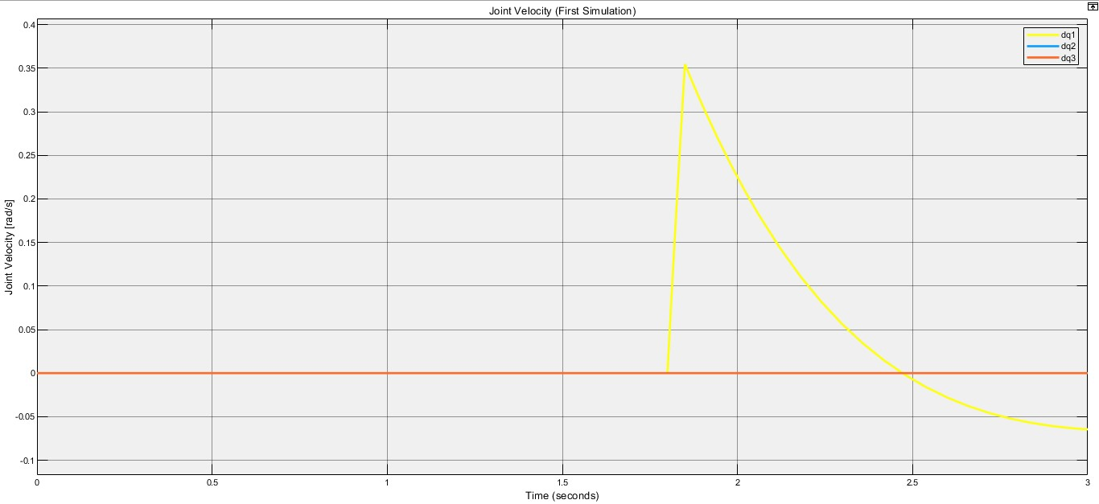
First Simulation: Joint Velocity

Slide 22
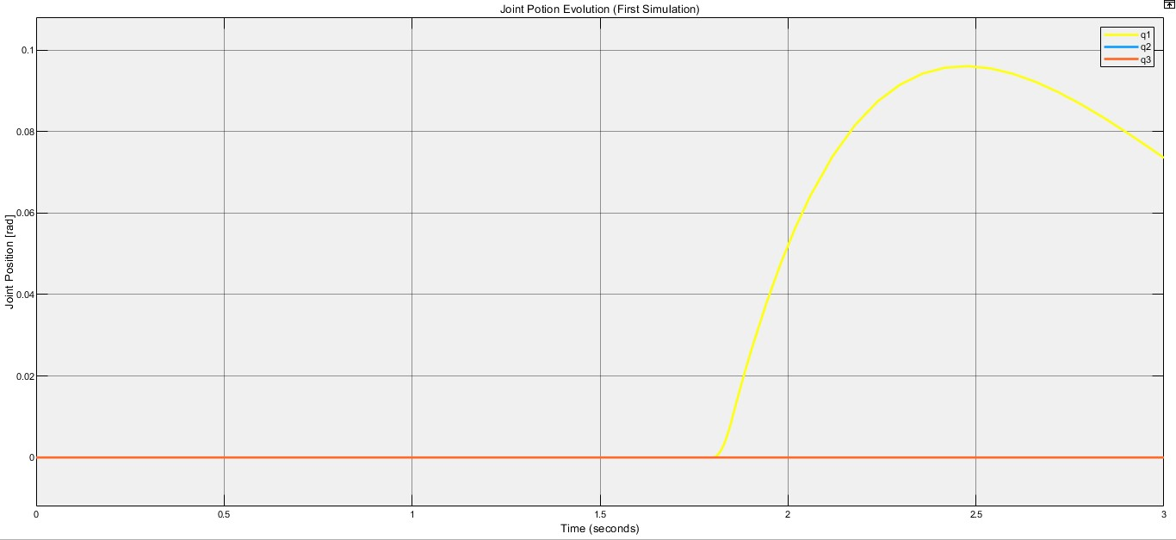
First Simulation: Joint Position

Slide 23
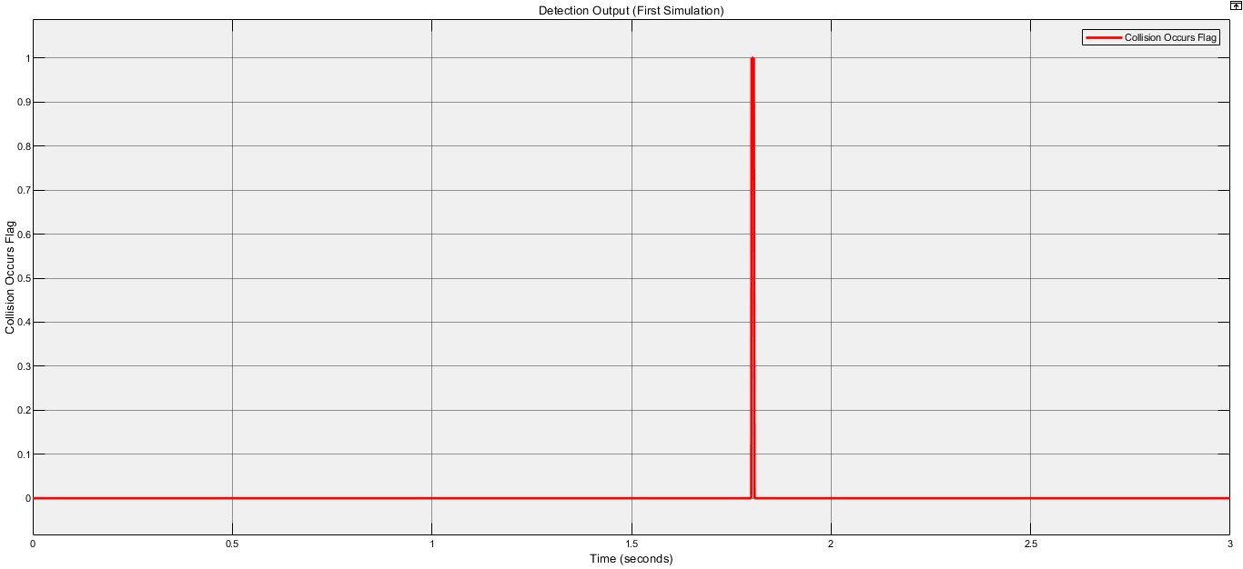
First Simulation: Detection

Slide 24
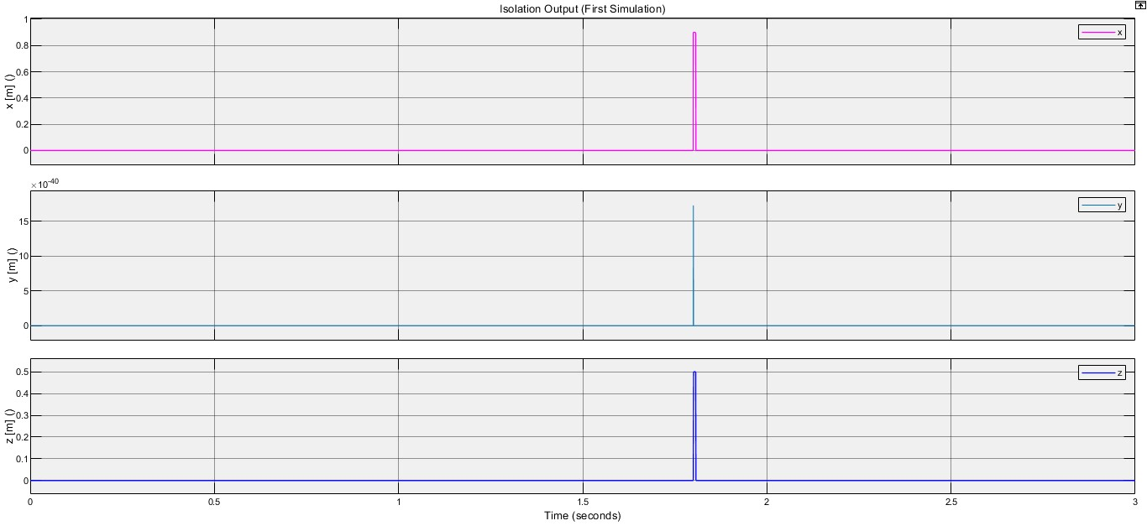
First Simulation: Isolation

Slide 25
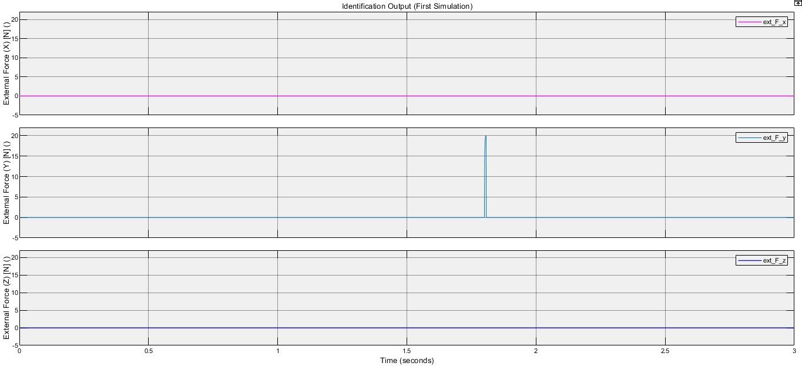
First Simulation: Identification

Slide 26
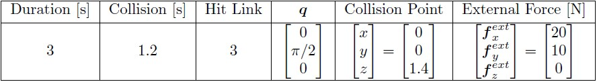
Second Simulation
Below the 6th joint
Singularity

Slide 27
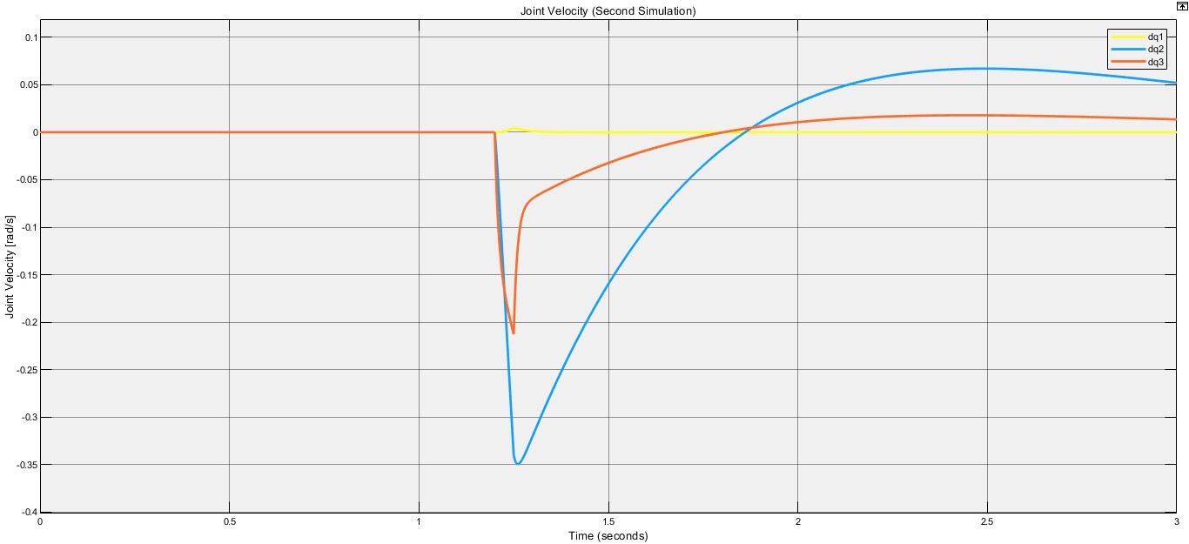
Second Simulation: Joint Velocity

Slide 28
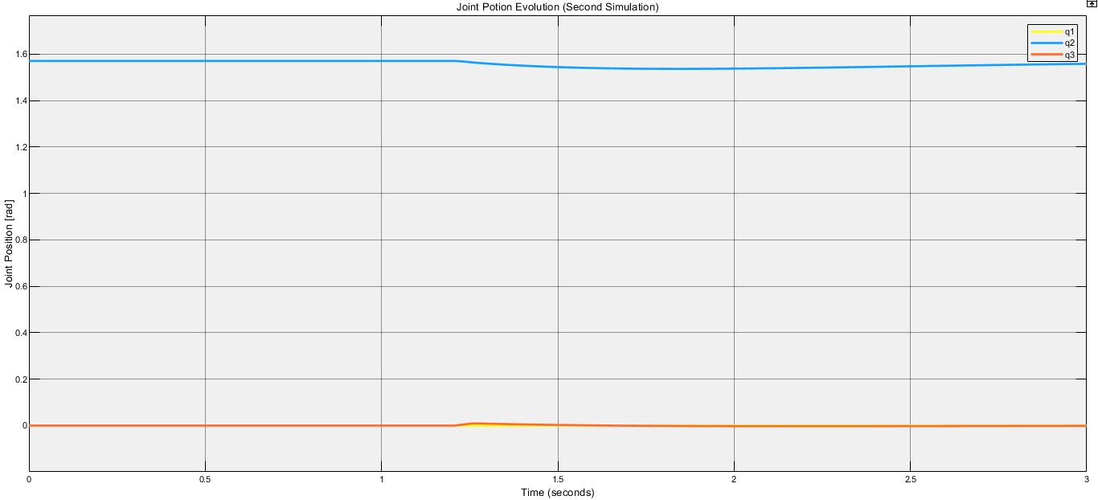
Second Simulation: Joint Potion

Slide 29
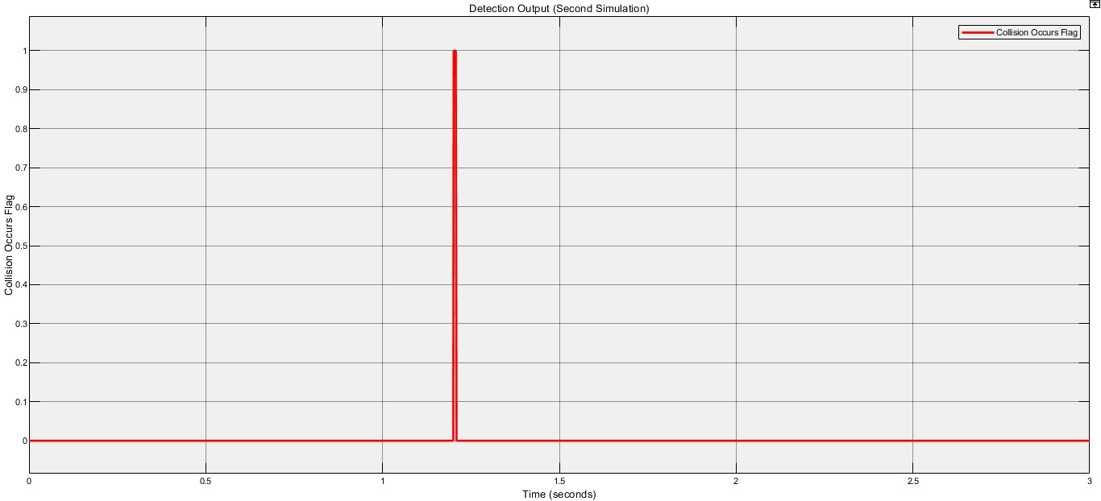
Second Simulation: Detection

Slide 30
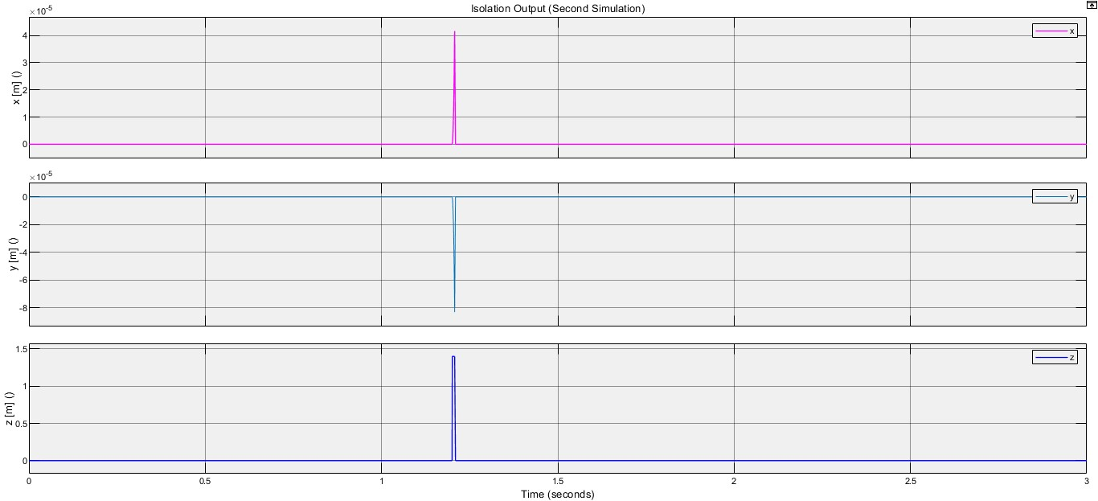
Second Simulation: Isolation

Slide 31
Second Simulation: Identification

Slide 32
Conclusions

Slide 33
Conclusions
Decoupled force-torque estimations
Independence from joint configuration and immunity to singularities
High accuracy despite singularity and external torques at joint level

